Slide 1

4. Testing the Data

Slide 2
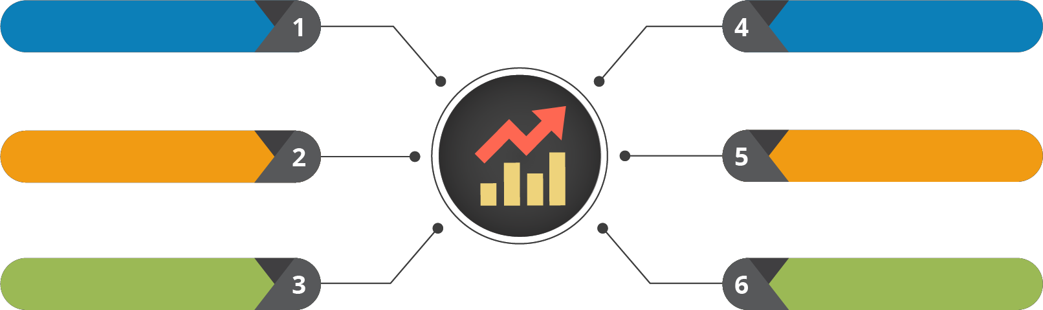
Course Outline
Understanding the Data
Testing the Data
Probability and its Uses
Data Clustering
Statistical Inference
Regression Modelling

Slide 3

Course Objectives
After completing this module, you should be able to:
Understand Parametric Test
Understand Non-Parametric Test
Understand A/B testing

Slide 4


1. Statistical Testing

Slide 5

Statistical Testing

Slide 6









Statistical Testing
Statistical Tests are intended to decide whether a hypothesis about
distribution of one or more populations should be accepted or rejected
Statistical Tests
Parametric
Tests
Non Parametric
Tests

Slide 7
Why to Use Statistical Testing?
To calculate the difference in the sample and population means
To find the difference in sample means
To test the significance of association between two variables
To calculate several population means
To test the difference in proportions between two independent populations
To test the difference in proportion
between samples and population

Slide 8
2. Parametric Testing

Slide 9

Parametric Testing

Slide 10




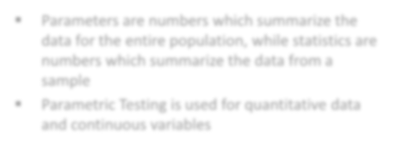











What are Parameters?
Time
Parameters are numbers which summarize the data for the entire population, while statistics are numbers which summarize the data from a sample
Parametric Testing is used for quantitative data and continuous variables
Performance
Scope
Goals

Slide 11




Parametric Testing
A parametric test makes assumption regarding population parameters and distribution
Z Testing
Student -T Testing
P Testing
ANOVA Testing

Slide 12





Z Testing
The Z Test is used for testing significance difference between two point estimates
The sample must be randomly selected and data must be quantitative
Assumptions for Z Test
Samples should be larger
Data should follow a normal distribution

Slide 13














Steps for Z Testing
Step01
State the null hypothesis and alternate hypothesis
Step02
Choose an alpha level
Step03
Find the critical value of z in z table
Step04
Calculate the z test statistics
Step05
Compare the test statistic to the critical z value and decide if you should support or reject the null hypothesis

Slide 14









Significance & Confidence Levels
Significance Level
Confidence Level
Significance level is the probability of rejecting the null hypothesis when it is true, which is known as Type I error
Denoted by 𝜶
The Confidence level is just the compliment of Significance level which signifies how confident you are in your decision
Expressed as: 1 - 𝜶

Slide 15











Example – Z Testing
Boys of a certain age are known to have a mean weight of μ = 85 pounds. A complaint is made, that the boys living in a municipal children's home are underfed. As one bit of evidence, n = 25 boys (of the same age) are weighed and found to have a mean weight of x = 80.94 pounds. It is known that the population standard deviation σ is 11.6 pounds
n=25
x = 80.94 pounds
μ = 85 pounds

Slide 16









Example – Z Testing
Solution
The null hypothesis is H₀: μ = 85, and the alternative hypothesis is H_{A}: μ < 85
𝑥ҧ − 𝜇
𝑧 =
𝜎Τ 𝑛
Follows the standard normal N (0,1) distribution. It is actually a bit irrelevant here, whether or not the weights are normally distributed, because the same size n = 25 is large enough for the Central Limit Theorem to apply. In that case, we know that Z, as defined above, follows at least approximately the standard normal distribution
𝑥ҧ − 𝜇₀
𝜎Τ 𝑛
𝑧 =

Slide 17









Example – Z Testing
For testing the null hypothesis
H0: μ=μ0
against any of the possible alternative hypotheses
HA: μ≠μ0, HA: μ<μ0, and HA :μ>μ0

Slide 18


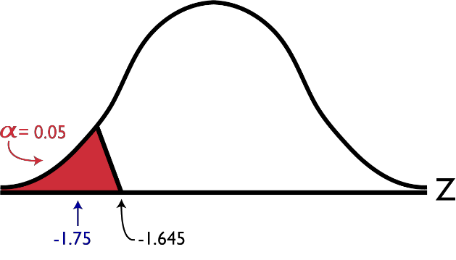


Example – Z Testing
For the example in hand, the value of the test statistic is
80.94 − 85
𝑧 =
= −1.75
11.6Τ 25
The critical region approach tells us to reject the null hypothesis at the α = 0.05 level if Z < −1.645. Therefore, we reject the null hypothesis because Z = −1.75
< −1.645, and therefore falls in the rejection region
Calculated z value

Slide 19


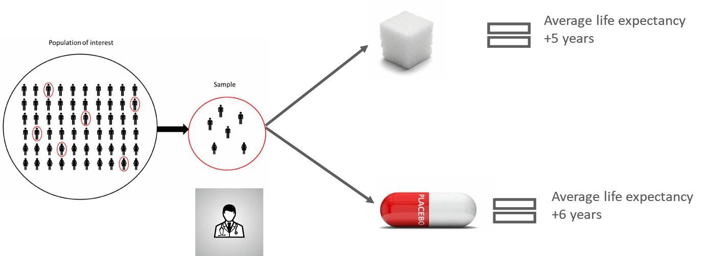
T Testing
A T test is one of the most frequently used procedures in statistics
The t test (also called Student’s T Test) compares two point estimates and tells you if they are different from each other
A doctor experimented upon a sample under his controlled group, the results are as shown below

Slide 20



T Score
The t score is a ration between the difference between two groups and
difference within two groups
A Large t-score tells you that the groups are different
A Small t-score tells you that the groups are similar
𝑥ҧ − 𝜇₀
𝑡 =
𝑠Τ 𝑛

Slide 21
Let’s Understand the Concept of
Degree of Freedom

Slide 22






Degree of Freedom
You have a data set with 10 values. If you are not estimating anything, each value can take on any number. Each value is completely free to vary
By definition of the mean, the sum of all values in the data must equal n * mean, where n is the number of values in the data set
So if a data set has 10 values, the sum of the 10
values must equal the mean x 10. If the mean of the 10 values is
3.5 (you could pick any number), this constraint requires that the
sum of the 10 values must equal 10 x 3.5 = 35

Slide 23






Degree of Freedom
With that constraint, the first value in the data set is free to vary. Whatever value it is, it’s still possible for the sum of all 10 numbers to have a value of 35. The second value is also free to vary, because whatever value you choose, it still allows for the possibility that the sum of all the values is 35
Example:
But to have all 10 values sum to 35, and have a mean of 3.5, the 10th value cannot vary. It must be a specific number:
34, -8.3, -37, -92, -1, 0, 1, -22, 99
>>> 10TH value must be 61.3
0.1, 0.2, 0.3, 0.4, 0.5, 0.6, 0.7, 0.8, 0.9
>>> 10TH value must be 30.5
Example:
The first 9 values could be anything, including these two examples:
34, -8.3, -37, -92, -1, 0, 1, -22, 99
0.1, 0.2, 0.3, 0.4, 0.5, 0.6, 0.7, 0.8, 0.9

Slide 24

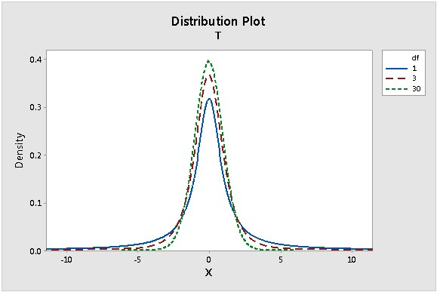


Degree of Freedom
The number of degrees of freedom equals the number of "observations" minus the number of required relations among the observations (e.g., the number of parameter estimates). For a 1-sample t- test, one degree of freedom is spent estimating the mean, and the remaining n - 1 degrees of freedom estimate variability

Slide 25
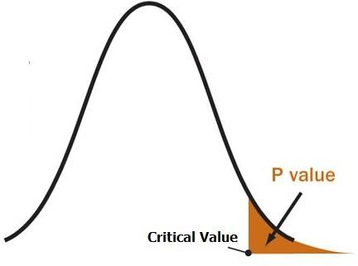
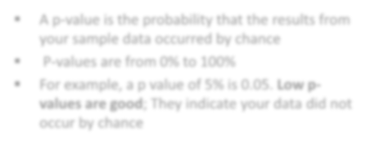
P-Value
A p-value is the probability that the results from your sample data occurred by chance
P-values are from 0% to 100%
For example, a p value of 5% is 0.05. Low p- values are good; They indicate your data did not occur by chance
In most of the cases, a p-value of 0.05 is accepted to mean the data is valid

Slide 26






T - Testing
One Sample T Test
To test whether the mean of a sample (x) differs significantly from a predicted value (µ)
𝑆
𝑥ҧ − 𝜇
^{𝑡 =} 𝑆𝐸𝑀
𝑆𝐸𝑀 =
𝑛
Standard Error of Mean
t statistics

Slide 27



T - Testing
Two Sample T Test
To test whether the mean of a sample (bar-x1) differs
significantly from the mean of another sample (bar-x2)
𝑣𝑎𝑟₁ +𝑣𝑎𝑟₂
𝑛₁ 𝑛₂
𝑥₁ − 𝑥₂
𝑡 =
𝑆𝐸𝑀 =
𝑆𝐸𝑀
Standard Error of Mean
t statistics

Slide 28


Example - T - Testing
Calculate a paired t test by hand for the following data
Subject | Score 1 | Score 2
1 | 3 | 20
2 | 3 | 13
3 | 3 | 13
4 | 12 | 20
5 | 15 | 29
6 | 16 | 32
7 | 17 | 23
8 | 19 | 20
9 | 23 | 25
10 | 24 | 15
11 | 32 | 30

Slide 29






Example - T - Testing
Step 1 Subtract each Y score from each X score
Subject | Score 1 | Score 2 | Score 1-Score2
1 | 3 | 20 | -17
2 | 3 | 13 | -10
3 | 3 | 13 | -10
4 | 12 | 20 | -8
5 | 15 | 29 | -14
6 | 16 | 32 | -16
7 | 17 | 23 | -6
8 | 19 | 20 | -1
9 | 23 | 25 | -2
10 | 24 | 15 | 9
11 | 32 | 30 | 2

Slide 30



Example - T - Testing
Subject | Score 1 | Score 2 | Score 1-Score2
1 | 3 | 20 | -17
2 | 3 | 13 | -10
3 | 3 | 13 | -10
4 | 12 | 20 | -8
5 | 15 | 29 | -14
6 | 16 | 32 | -16
7 | 17 | 23 | -6
8 | 19 | 20 | -1
9 | 23 | 25 | -2
10 | 24 | 15 | 9
11 | 32 | 30 | 2
 |  | Sum | -73
Step 2
Add up all of the values from Step 1

Slide 31


Example - T - Testing
Subject | Score 1 | Score 2 | Score 1- Score2 | (Score1- Score2)^2
1 | 3 | 20 | -17 | 289
2 | 3 | 13 | -10 | 100
3 | 3 | 13 | -10 | 100
4 | 12 | 20 | -8 | 64
5 | 15 | 29 | -14 | 196
6 | 16 | 32 | -16 | 256
7 | 17 | 23 | -6 | 36
8 | 19 | 20 | -1 | 1
9 | 23 | 25 | -2 | 4
10 | 24 | 15 | 9 | 81
11 | 32 | 30 | 2 | 4
 |  | Sum | -73
Step 3
Square the differences from Step 1

Slide 32

Example - T - Testing
Subject | Score 1 | Score 2 | Score 1- Score2 | (Score1- Score2)^2
1 | 3 | 20 | -17 | 289
2 | 3 | 13 | -10 | 100
3 | 3 | 13 | -10 | 100
4 | 12 | 20 | -8 | 64
5 | 15 | 29 | -14 | 196
6 | 16 | 32 | -16 | 256
7 | 17 | 23 | -6 | 36
8 | 19 | 20 | -1 | 1
9 | 23 | 25 | -2 | 4
10 | 24 | 15 | 9 | 81
11 | 32 | 30 | 2 | 4
 |  | Sum | -73 | 1131
Step 4
Add up all of the squared differences from Step 3

Slide 33




Example - T - Testing
Step 5 Use the following formula to calculate the t-score
σ 𝐷 Τ𝑛
𝑡 =
𝛴𝐷
2
σ 𝐷² −
𝑛
𝑛 − 1 𝑛
ΣD: Sum of the differences (Sum of X-Y from Step 2) ΣD²: Sum of the squared differences (from Step 4) (ΣD)²: Sum of the differences (from Step 2), squared

Slide 34

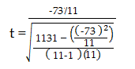

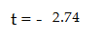
Example - T - Testing
Subtract 1 from the sample size to get the degrees of freedom. We have 11 items, so 11-1 = 10

Slide 35






Example - T - Testing
A researcher compared the height of plants grown in high and low light levels. His results are shown below
Low_Light | High_Light
49 | 45
31 | 40
43 | 59
31 | 58
40 | 55
44 | 50
49 | 46
48 | 53
33 | 43

Slide 36



Solution - T - Testing
Use a T-test to determine whether there is a statistically
significant difference in the heights of the two groups
import pandas as pd
from scipy.stats import ttest_ind, ttest_ind_from_stats
df=pd.read_csv('T-test.csv')
print(df)
var1=df['Low_Light'].values var2=df['High_Light'].values
print(var1)
print(var2)
t, p = ttest_ind(var1, var2, equal_var=False) print("ttest_ind: t = %g p = %g" % (t, p))

Slide 37



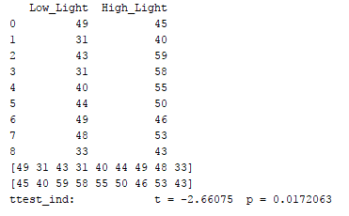


Solution - T - Testing
𝑛 = 9
ⅆ𝑓 = 𝑛 − 1 = 8
𝛼 = 0.05
As P value < 𝛼, null hypothesis is rejected

Slide 38





ANOVA Testing
An ANOVA test is a way to find out if survey or experiments are significant. This testing helps you
to figure out if you need to reject the null hypothesis or accept the alternate hypothesis
A group of psychiatric patients is trying three different therapies: counselling, medication
and biofeedback. You want to see if one therapy is better than the others
A manufacturer has two different process to make medicines. They want to know which process is better
Examples where the ANOVA testing is used:
Students from different colleges take the same exam. You want to see if one college outperforms the other

Slide 39








Types of ANOVA Testing
ANOVA Testing
One way
ANOVA Testing
Two way ANOVA Testing

Slide 40





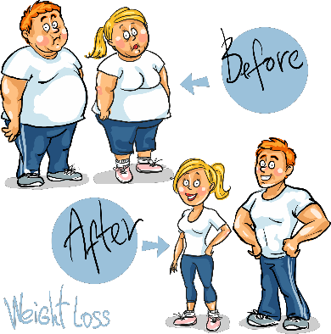

One way ANOVA Testing
One way ANOVA testing is used to compare two means from two or more independent groups. The null hypothesis for the test is what two means are equal. Therefore, a significant means that the two means are unequal
Example:
You might be studying the effects of tea on weight loss and form three groups: green tea, black tea, and no tea

Slide 41






Example - One Way ANOVA Testing
A researcher fed fishes on four different foods. At the end of a month feeding, he weighed the fishes
food1 | food2 | food3
31 | 79 | 55
32 | 48 | 46
53 | 49 | 45

Slide 42








Solution - One Way ANOVA Testing
Use an ANOVA test to determine if the different foods resulted in differences in the growth of the fishes
import numpy as np
from scipy import stats
food1 = np.array([ 31, 32, 53 ])
food2 = np.array([ 79, 48, 49 ])
food3= np.array([ 55, 46, 45])
print(stats.f_oneway(food1, food2, food3))
Output
As P value > 𝛼, null hypothesis is not rejected
The differences between some of the means are statistically insignificant

Slide 43
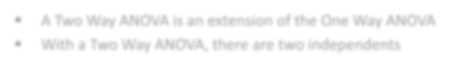







Two Way ANOVA Testing
A Two Way ANOVA is an extension of the One Way ANOVA
With a Two Way ANOVA, there are two independents
Example:
You might want to find out if there is an interaction between income and gender for anxiety level at job interviews. The anxiety level is the outcome, or the variable that can be measured

Slide 44
3. Non-Parametric Testing

Slide 45
Non-Parametric Testing

Slide 46

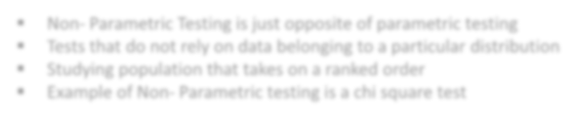







Non Parametric Testing
Non- Parametric Testing is just opposite of parametric testing
Tests that do not rely on data belonging to a particular distribution
Studying population that takes on a ranked order
Example of Non- Parametric testing is a chi square test
1
2
3
4
5

Slide 47

Chi-Square Testing
A chi-square statistic is one way to show a relationship between two categorical variables
The chi-squared statistic is a single number that tells you how much difference exists between your observed counts and the counts you would expect if there were no relationship at all in the population

Slide 48




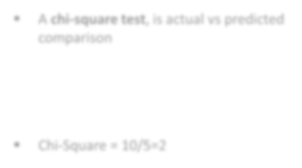
Chi-Square Testing
Face of Dice | Actual (O) | Prediction (E) | Diff. (O-E) | (O-E)²
1 | 3 | 5 | -2 | 4
2 | 4 | 5 | -1 | 1
3 | 6 | 5 | 1 | 1
4 | 5 | 5 | 0 | 0
5 | 5 | 5 | 0 | 0
6 | 7 | 5 | 2 | 4
A chi-square test, is actual vs predicted
comparison
෌ 0 − 𝐸
2
𝑥² =
𝐸
Chi-Square = 10/5=2

Slide 49

Example - Chi - Square Testing
Category | Observed | Expected | (Obs-Exp) | (Obs- Exp)^2 | ((Obs- Exp)^2)/Exp
Aries | 29
Taurus | 24
Gemini | 22
Cancer | 19
Leo | 21
Virgo | 18
Libra | 19
Scorpio | 20
Sagittarius | 23
Capricorn | 18
Aquarius | 20
Pisces | 23
256 visual artists were surveyed to find out their zodiac sign. The results were: Aries (29), Taurus (24), Gemini (22), Cancer (19), Leo (21), Virgo (18), Libra (19), Scorpio (20), Sagittarius (23), Capricorn (18), Aquarius (20), Pisces (23)

Slide 50



Example - Chi - Square Testing
Category | Observed | Expected | (Obs-Exp) | (Obs-Exp)^2 | ((Obs- Exp)^2)/Exp
Aries | 29 | 21.333
Taurus | 24 | 21.333
Gemini | 22 | 21.333
Cancer | 19 | 21.333
Leo | 21 | 21.333
Virgo | 18 | 21.333
Libra | 19 | 21.333
Scorpio | 20 | 21.333
Sagittarius | 23 | 21.333
Capricorn | 18 | 21.333
Aquarius | 20 | 21.333
Pisces | 23 | 21.333
Step 1
Expected value=256/11
=21.33

Slide 51
Example - Chi - Square Testing
Category | Observed | Expected | (Obs-Exp) | (Obs-Exp)^2 | ((Obs- Exp)^2)/Exp
Aries | 29 | 21.333 | 7.667
Taurus | 24 | 21.333 | 2.667
Gemini | 22 | 21.333 | 0.667
Cancer | 19 | 21.333 | -2.333
Leo | 21 | 21.333 | -0.333
Virgo | 18 | 21.333 | -3.333
Libra | 19 | 21.333 | -2.333
Scorpio | 20 | 21.333 | -1.333
Sagittarius | 23 | 21.333 | 1.667
Capricorn | 18 | 21.333 | -3.333
Aquarius | 20 | 21.333 | -1.333
Pisces | 23 | 21.333 | 1.667
Step 2

Slide 52
Example - Chi - Square Testing
Category | Observed | Expected | (Obs-Exp) | (Obs-Exp)^2 | ((Obs- Exp)^2)/Exp
Aries | 29 | 21.333 | 7.667 | 58.782889
Taurus | 24 | 21.333 | 2.667 | 7.112889
Gemini | 22 | 21.333 | 0.667 | 0.44889
Cancer | 19 | 21.333 | -2.333 | 5.442889
Leo | 21 | 21.333 | -0.333 | 0.110889
Virgo | 18 | 21.333 | -3.333 | 11.108889
Libra | 19 | 21.333 | -2.333 | 5.442889
Scorpio | 20 | 21.333 | -1.333 | 1.776889
Sagittarius | 23 | 21.333 | 1.667 | 2.778889
Capricorn | 18 | 21.333 | -3.333 | 11.108889
Aquarius | 20 | 21.333 | -1.333 | 1.776889
Pisces | 23 | 21.333 | 1.667 | 2.778889
Step 3

Slide 53

Example - Chi - Square Testing
Category | Observed | Expected | (Obs-Exp) | (Obs-Exp)^2 | ((Obs- Exp)^2)/Exp
Aries | 29 | 21.333 | 7.667 | 58.782889 | 2.755490976
Taurus | 24 | 21.333 | 2.667 | 7.112889 | 0.333421882
Gemini | 22 | 21.333 | 0.667 | 0.44889 | 0.021042048
Cancer | 19 | 21.333 | -2.333 | 5.442889 | 0.255139408
Leo | 21 | 21.333 | -0.333 | 0.110889 | 0.005198003
Virgo | 18 | 21.333 | -3.333 | 11.108889 | 0.520737308
Libra | 19 | 21.333 | -2.333 | 5.442889 | 0.255139408
Scorpio | 20 | 21.333 | -1.333 | 1.776889 | 0.083292973
Sagittarius | 23 | 21.333 | 1.667 | 2.778889 | 0.130262457
Capricorn | 18 | 21.333 | -3.333 | 11.108889 | 0.520737308
Aquarius | 20 | 21.333 | -1.333 | 1.776889 | 0.083292973
Pisces | 23 | 21.333 | 1.667 | 2.778889 | 0.130262457
Step 4

Slide 54
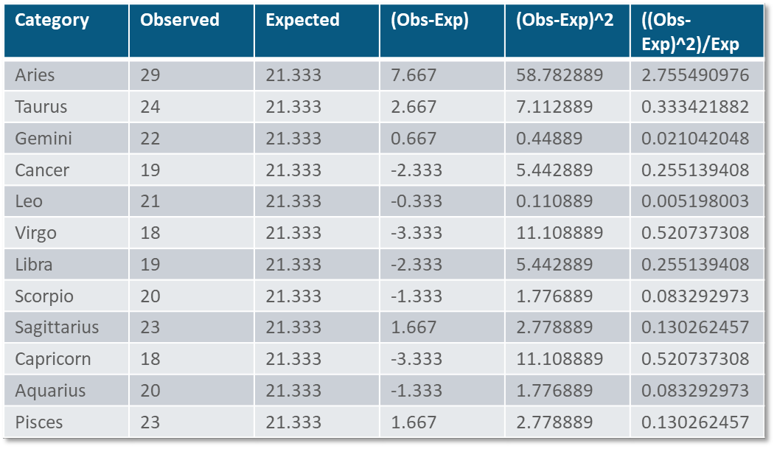


Example - Chi - Square Testing
5.094
This is the chi-square statistic: 5.094

Slide 55
Use Case – Non Parametric Testing

Slide 56

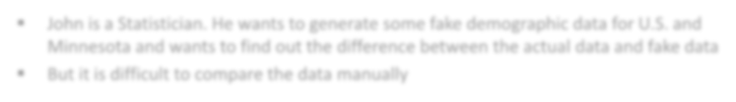



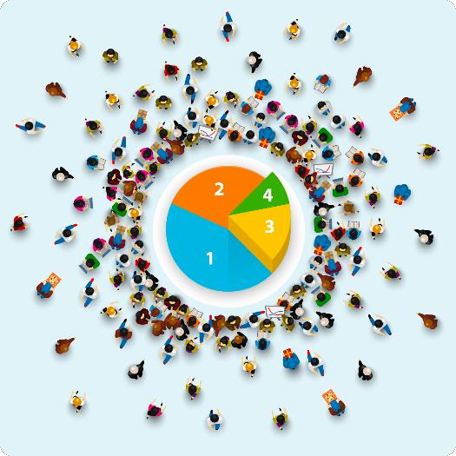



Use Case
John is a Statistician. He wants to generate some fake demographic data for U.S. and Minnesota and wants to find out the difference between the actual data and fake data
But it is difficult to compare the data manually
John

Slide 57


Use Case - Solution
This problem can be solved using Non Parametric Testing – Chi-Square method
import numpy as np
import pandas as pd
import scipy.stats as stats
national = pd.DataFrame(["white"] * 100000 + ["hispanic"] * 60000 + \
["black"] * 50000 + ["asian"] * 15000 + ["other"] * 35000)
minnesota = pd.DataFrame(["white"] * 600 + ["hispanic"] * 300 + \
["black"] * 250 + ["asian"] * 75 + ["other"] * 150)
national_table = pd.crosstab(index=national[0], columns="count") minnesota_table = pd.crosstab(index=minnesota[0], columns="count")
print("National") print(national_table) print(" ") print("Minnesota") print(minnesota_table)

Slide 58



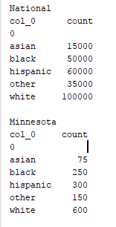

Use Case - Solution
import numpy as np
import pandas as pd
import scipy.stats as stats
national = pd.DataFrame(["white"] * 100000 + ["hispanic"] * 60000 + \
["black"] * 50000 + ["asian"] * 15000 + ["other"] * 35000)
minnesota = pd.DataFrame(["white"] * 600 + ["hispanic"] * 300 + \
["black"] * 250 + ["asian"] * 75 + ["other"] * 150)
national_table = pd.crosstab(index=national[0], columns="count") minnesota_table = pd.crosstab(index=minnesota[0], columns="count") print("National")
print(national_table) print(" ") print("Minnesota")
print(minnesota_table)
Output

Slide 59




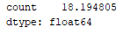
Use Case - Solution
observed = minnesota_table
national_ratios = national_table/len(national)
# Get population ratios
expected = national_ratios * len(minnesota) # Get expected counts
chi_squared_stat = (((observed-expected)**2)/expected).sum() print(chi_squared_stat)
Output

Slide 60




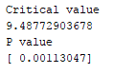

Use Case - Solution
crit = stats.chi2.ppf(q = 0.95, # Find the critical value for 95% confidence*
df = 4) # Df = number of variable categories - 1
print("Critical value") print(crit)
p_value = 1 - stats.chi2.cdf(x=chi_squared_stat,
df=4)
print("P value")
print(p_value)
# Find the p-value
stats.chisquare(f_obs= observed,
f_exp= expected)
# Array of observed counts # Array of expected counts
Output

Slide 61



Use Case - Solution
crit = stats.chi2.ppf(q = 0.95, # Find the critical value for 95% confidence*
df = 4) print("Critical value") print(crit)
# Df = number of variable categories - 1
p_value = 1 - stats.chi2.cdf(x=chi_squared_stat,
df=4)
print("P value") print(p_value)
# Find the p-value
stats.chisquare(f_obs= observed,
f_exp= expected)
# Array of observed counts # Array of expected counts
As the P value is < 0.05, we reject the null hypothesis that the two distributions are the same

Slide 62



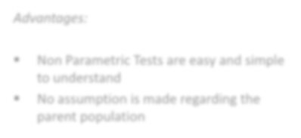
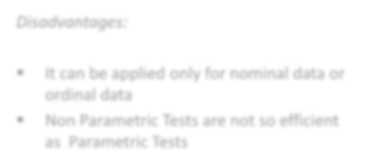
Advantages and Disadvantages - Non Parametric Test
Advantages:
Disadvantages:
Non Parametric Tests are easy and simple to understand
No assumption is made regarding the parent population
It can be applied only for nominal data or ordinal data
Non Parametric Tests are not so efficient as Parametric Tests

Slide 63
Difference between Parametric Test & Non parametric Test

Slide 64

Parametric Test vs. Non Parametric Test
Parametric Test | Non Parametric Test
Information about population is completely known | No information about population is available
Specific assumptions are made regarding the population | No assumptions are made regarding the population
Null hypothesis is made on parameters of the population distribution | The null hypothesis is free from parameters
Test statistics is based on the distribution | Test statistics is arbitrary
Parametric tests are available only for variables | It is applicable for both variables and attributes
Parametric tests are powerful, if exists | It is not powerful as Parametric tests

Slide 65
4. A/B Testing

Slide 66
A/B Testing

Slide 67


A/B Testing
A/B Testing is essentially an experiment where two or more variants of a page are shown to users at random and statistical analysis is used to determine which variance performs better for a given conversion goal
A/B Testing is a method of comparing two versions of web pages or app against each other to determine which one performs better
.

Slide 68
Why you Should A/B Test?
A/B testing allows individuals, teams, and companies make careful changes to their user experiences while collecting data on the results
01
Combine the effect of multiple winning changes from experiments to demonstrate the measurable improvement of the new experience over the old one
02
In order to achieve increased sales from campaign landing pages, the team would try A/B testing changes to the headline, visual imagery, form fields, call to action, and overall layout of the page
04
03
More than just answering a one-off question or settling a disagreement, AB testing can be used consistently to continually improve a given experience, improving a single goal like conversion rate over time

Slide 69


4 Steps of A/B Testing
Analyze Data:
Define your objective and metrics to test
Form a hypothesis:
Define your testing strategy
Construct an experiment:
Select technology for
test
Interpret result:
Review analytics, implement the winner and try again

Slide 70


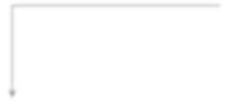









A/B Testing Can be Done with
A/B Testing
Call to Action
Buttons
Email Subject Lines
Any Web Communication Element
Landing Pages
Logos

Slide 71




Example - A/B Testing
Fabtech is a content provider company that streams courses and live sessions
This company is advertising a new course at the home page of their website, but they got a bunch of other cool pictures available and they do not know if the one being used is the one that makes their users more likely to click on the course

Slide 72


Example - A/B Testing
To start off they select a small percentage of users to participate in the experiment. They do that because
if it happens to be a bad experience, they do not want to impact many users. Let's select 10% of them
680
700

Slide 73




Example - A/B Testing
When they compare result of Page A with Page B, found that percentage of visitors converted into users is more about Page A is more than Page B
So Fabtech has decided to keep Page A as their website’s home page

Slide 74

Summary
In this module, you should have learnt:
Understand Parametric Test
Understand Non-Parametric Test
Understand A/B testing

Slide 75


Congratulation
Probability & Statistics
for Data Science
You have successfully completed –
Testing the Data Session

Slide 76





Next Topic, We will see the
Data Clustering
Okay, I clearly understand the Testing the Data
What Next?

Slide 77



Slide 78


Slide 79


Slide 80


